Slide 1
Culture's influence on leadership efficiency: How personal and national cultures affect leadership style
Presented By:
Rabia Usman 2021-CS-112
Suman Shahzad 2021-CS-131
Sana Rashid 2021-CS-135

Slide 2
Agenda
01
05
Introduction
Hypothesis
02
06
Research Methodology
Why this Matters?
03
07
Schwartz’s Framework
Real World Applications
04
08
Key Findings
Conclusion
Notes:
“Leadership is not one-size-fits-all. The best leaders know how to adapt. “In conclusion, there is no universal leadership style. Cultural values play a bigger role than personal values in shaping how leaders succeed. The most successful businesses are those that adapt their leadership styles to fit the cultural context.”

Slide 3
Introduction
Research Objective
Data Analysis
Compared different leadership approaches using statistical methods and case studies.
Understand how personal values and national culture influence leadership styles and business success.
Data Collection
Key Findings
Studied 159 companies across Denmark, Finland, and Ireland to compare leadership differences.
Leadership is not universal; cultural values are stronger than personal values in shaping leadership effectiveness.
Measuring Leadership
Used Schwartz’s Value Theory to analyse leadership based on:
Personal Values (individual beliefs)
Cultural Values (shared national traits)
Leadership Styles (how leaders behave)
Practical Applications
Companies must adapt leadership styles based on culture and hire local leaders to succeed globally.
Notes:
"Think of leadership like a recipe. Personal values are the ingredients, but the national culture is the cookbook that tells you how to mix them."

Slide 4
Key Concepts
Personal Values
National Culture
Leadership Style
What a leader personally believes (e.g., creativity, responsibility).
Shared behaviours of a country (e.g., tradition, openness).
How leaders act based on values and culture.
Notes:
"Think of leadership as cooking. The personal values are the chef’s skills, and the national culture is the recipe they must follow."

Slide 5
Research Methodology
Research Objective
Variables & Leadership Measurement
Key Findings
1. Leadership success varies by country - One style does not work everywhere.
2. Cultural values shape leadership more than personal values.
3. Leaders who align with their country’s cultural expectations tend to perform better.
1. The study analyzes leadership effectiveness based on personal values vs. cultural values.
2. It explores whether leaders succeed because of their own beliefs or because they align with their national culture.
Independent Variables (What was measured?):
Personal Values: Individual beliefs like innovation, responsibility, and ambition.
Cultural Values: shared societal norms like teamwork, hierarchy, and stability.
Dependent Variable (What was analysed?):
Leadership Style: How leaders behave based on their values and cultural influences.
Data Collection
Practical Applications
Data Analysis Methods
1. 159 companies were studied from Denmark, Finland, and Ireland.
2. Data was collected from CEOs and top managers across different industries.
3. These countries were selected because they are economically competitive but have different leadership styles.
1. Schwartz’s Value Theory was used to categorise personal and cultural values.
2. Statistical comparisons were made to see which values had a stronger impact on leadership success.
3. Leadership effectiveness was analysed based on company performance metrics.
1. Businesses must adjust leadership strategies based on national cultures.
2. Companies expanding internationally should hire local leaders who understand cultural expectations.
3. Understanding cultural differences improves leadership success in global markets.
Notes:
“This study looked at leaders in three countries and asked: What makes them successful—their personal beliefs or their country’s culture?”
Move through data collection → variables → analysis → findings step by step.
“What leadership traits do you think work best in your country?”

Slide 6
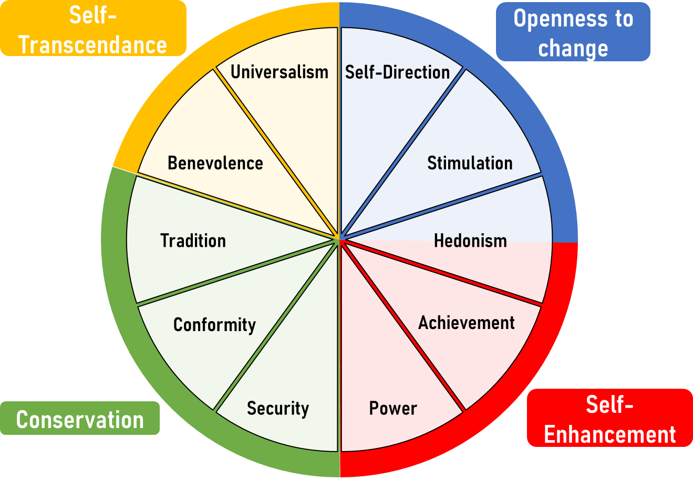
Schwartz’s Value Theory
The Structure of Schwartz’s Model
Personal Values:
Openness-to-Change: Creativity, independence, curiosity.
Conservation: Tradition, security, conformity.
Self-Transcendence: Protecting the environment, social justice.
Self-Enhancement: Achievement, power, influence.
Cultural Values:
Autonomy: Intellectual (creativity) vs. Affective (enjoyment).
Embeddedness: Tradition, hierarchy, stability.
Equalism:: Equality, fairness.
Notes:
How Values Shape Leadership

Slide 7
Applying Schwartz’s Framework
How the Study Used Schwartz’s Model
Data Collection:
CEOs ranked 57 personal values (e.g., "creativity") and 45 cultural values (e.g., "tradition").
Analysis:
Factor Analysis: Grouped values into leadership styles (e.g., Irish "openness-to-change").
Correlation: Linked values to performance (e.g., creativity → 64.2% success in Ireland).
Key Insight:
The framework revealed why culture overrides personal values (e.g., Danish hierarchy stifled innovation).
Values → Leadership Style → Performance
Notes:
How Values Shape Leadership

Slide 8
Leadership style by country
Country | Leadership Style | Key Values | Performance
Ireland | Open to Change & Innovation | Creativity, Independence, Innovation | 64.2% > 10% 📈
Finland | Conservation | Tradition, Security, Stability | 54.5% > 10% 📊
Denmark | Conservative & Less Open to Change | Hierarchy, Stability, Conformity | 41.2% > 10% 📉
Key Points:
Irish leaders scored highest on "creativity" (0.83 correlation) and "curiosity" (0.82).
Finnish/Danish leaders prioritized "tradition" and "hierarchy.".

Slide 9
What the Data Tell Us?
🌍 Cultural Values Dominate
Firm Performance
🌱 Shared Value: Protect the Environment
National culture explains 70% of leadership style (Wald = 4.606 vs. 1.916).
Cultural (70%) vs. Personal (30%) Influence on Leadership
🎯 Pluralistic Leadership Works
Only value common across all countries (p = 0.035).
Leaders valuing sustainability performed better globally.
Ireland’s "openness" = 64.2% success | Finland’s "conservation" = 54.5% success.
🌍 + 💼 = "Green leaders = Global success"

Slide 10
Hypothesis Results
Hypothesis | Result | Explanation
H₁: Pluralistic styles succeed | ✅ | Many leadership styles work, but they must match the country’s culture.
H₂: Leadership → Performance | ✅ | The right leadership style improves company success.
H₃: Culture ≠ Personal values | ✅ | Culture has a bigger impact than personal values.
H₄: Culture > Personal values | ✅ | Leadership is shaped more by national culture than by personal beliefs.

Slide 11
Why Cultural Adaptation in Leadership Matters?
Global success needs Local Smarts
One leadership style doesn’t fit every culture.
Adapting Leadership = Business Growth
Companies that align with local values thrive.
Real Impact
Understanding cultural differences isn’t just smart—it’s essential for global success.
2
1
3
Notes:
Global Success Needs Local Smarts Leadership isn’t universal. A style that works in one country might fail in another. Imagine trying to fit a square box in a round hole—that’s what it’s like when leadership doesn’t align with local culture. For example, in Finland, leaders are more traditional and cautious, so pushing rapid changes might backfire. On the other hand, Ireland values innovation and openness to change. Companies that understand and respect these differences are more likely to succeed globally.
Adapting Leadership = Business Growth “Think about McDonald’s. They change their menu in every country according to local tastes—spicy paneer burgers in India, chicken burgers in Pakistan. Leadership should be just as flexible. When companies adapt to local values, they build trust and thrive in new markets.”
Real Impact “Understanding cultural differences isn’t just a good strategy—it’s essential for global success. Companies that overlook these differences often struggle to connect with local teams, customers, and markets. Those that adapt can turn cultural challenges into competitive advantages.”

Slide 12

Real World Applications
Adapt leadership to local cultures.
Improves success by aligning with local norms.
International Expansion
Hiring Local Leaders
Shared Values
Social responsibility and ethical business practices gains trust globally.
Examples: Starbucks (China), Walmart (Germany)
Notes:
When companies expand internationally, they need leaders who understand the local culture. Hiring local leaders can bridge cultural gaps and improve business outcomes. Also, focusing on shared values, like social responsibility and ethical practices, creates common ground across different countries. Consumers globally expect businesses to act ethically, treating employees fairly and contributing to communities, which helps build a positive reputation.

Slide 13
How Starbucks Conquered China
A Case Study of Market Entry Strategy
Challenge
Adaptation
Result
Coffee culture was weak in China.
Introduced tea based drinks and created community focused atmosphere.
China became one of Starbucks' biggest markets.
Notes:
Starbucks faced a backlash in China, where tea, instead of coffee, was the preferred drink. They adapted by introducing tea-based drinks and creating a welcoming, community-focused environment. This cultural alignment turned China into one of Starbucks’ biggest market

Slide 14
Why Walmart Failed in Germany
A Leadership Misstep
Challenge
Mistake
Result
American-style practices clashed with German culture.
Friendly greeters and bagging groceries felt strange to German shoppers.
Walmart left Germany after failing to connect with customers.
Notes:
Walmart failed in Germany because they didn’t change their approach. In the U.S., friendly greeters and bagging groceries are normal, but in Germany, these practices felt uncomfortable to shoppers. Walmart didn’t adjust to the local culture, and as a result, they had to leave the German market.

Slide 15
Conclusion and Key Takeaways
Personal Values
Cultural
Values
Leadership Success
01
No One-Size Fits-All
Leadership styles must adapt to cultures
Cultural Values Shape Leadership
02
more than personal values
03
Success Requires Flexibility
in leadership across different countries
Notes:
“Leadership is not one-size-fits-all. The best leaders know how to adapt. “In conclusion, there is no universal leadership style. Cultural values play a bigger role than personal values in shaping how leaders succeed. The most successful businesses are those that adapt their leadership styles to fit the cultural context.”

Slide 16

Any Questions?
Thank you for your time!

